Slide 1

Energy Forecast Demonstrator (Arrowhead 4.0)
Thomas Pedersen

Slide 2
Energy-Forecast Overview
Old figure, the Orchestrator is also included in the 4.0 version.
All systems run in secure (TLS) mode.

Slide 3
Sample Data
Hourly outdoor temperatures over a year
Provided by PV systems, Department of Energy Technology, Aalborg University.
Indoor temperature
max(22.0, outTemp)
Building heat loss:
Formula based on building size and materials.
Brick walls, concrete floor, and asbestos roof.
Scaled to fit close with a real building.
Math.max(0, VENTILATION * (getIndoor(ts) - getOutdoor(ts)) * MATERIAL / SCALE)
Water heating:
Formula, similar to a measured data set.
-0.01f * getOutdoor(ts) + 0.3f

Slide 4
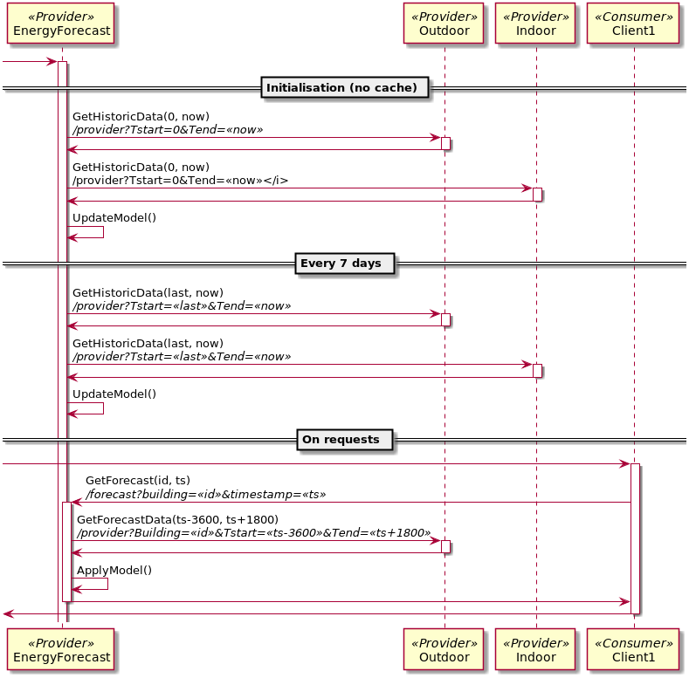
Energy Forecast Provider

Slide 5
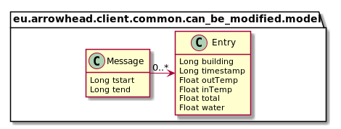
Data Model

